Slide 1
Career
Scientist/Student

Slide 2
Career (options)
Outreach
Policy
Science Writing
Administration
Law
Teaching
Science marketing
Industry
Research
Academic Research
Federal Funding Agencies
Community Service
Scientist/Student

Slide 3
Career (options)
Scientist/Student

Slide 4
Career (options)
Scientist/Student

Slide 5
Attitude
Confidence
Talents
Contributions to your environment
Determination
Sacrifice
Determining factors (friends, family)
Passion
Versus money
Integrity
Flexibility
Communication
Select mentor(s) cautiously and wisely
Two way relationship

Slide 6
Graduate Studies
Lifelong skills – communication, critical thinking, collaboration
‘Terminal degree’ – endless opportunities
Career flexibility – self directed, scholarly, travel, potential for impact outcomes, fun

Slide 7
Financing your graduate education
Assistantships, fellowships, external sources, loans, etc.
Assistantship – includes service
Teaching Assistantship
Research Assistantship
Fellowship – non-service
Certain fellowships can be supplemental to an assistantship
Interdisciplinary Competitive Fellowships Offered Through the Graduate School
Merit based
Includes mentored and interdisciplinary activities
Nominated by department
External Nationally Competitive Fellowships
Tuition, insurance, and fees

Slide 8
Application Process
Admission is competitive and requirements vary by department
Stats: 2006
11,000 applications
3,000 accepted (30%)
Decision based on application information:
Academic degrees and record
Statement of purpose
Letters of recommendation
Test scores
Relevant work experience

Slide 9
Submission
On-line submission with supplemental materials mailed
Separate fee and application for each program
max three/year
deadlines vary with department
$70/application
Deadline
All deadlines posted on the web by department
Communicate with your departments of interest – confirm deadlines, get yourself known
Indicate when applying for admission your interest in an assistantship
Application Process

Slide 10
Application Process
Academic record
Applicants must have an undergraduate degree from an accredited college or university
Seek good academic advising (take the right courses for the right reasons)
Standardized Tests*
GPA 3.54 or > than 3rd percentile
GRE - V 583 or > 50th percentile
GRE - Q 673 or > 50th percentile
GRE - A 660 or > 50th percentile
TOEFL (test of English as a foreign language)
Statement of Purpose
Letters of Recommendation

Slide 11
Preparation for Graduate School
What can (should) I be doing now?

Slide 12
Academics
Consider the following:
Selection criteria vary between programs
Major courses – do well
Challenge yourself – upper level courses
Transcripts are evaluated on courses and trends
GRE – Math, Reading, Vocabulary, Writing, Reasoning

Slide 13
Experience – how do you get it? (and why does it matter?)
Determine what you like and dislike
Internships, entry level positions
Inquire about career paths
Determine if advanced degree is necessary
Experience is key

Slide 14
Summer Internships
Benefits?
Learn skills
Working environment
Network
$$$
Recommendations for graduate school
Applications similar to graduate school

Slide 15
Summer Internships
Fall – Check websites (see handouts)
Winter – select programs, write personal statement, gather recommendations, transcripts
Jan-March – Submit applications
April – decide on program of choice

Slide 16
Make your Application as Competitive as possible
Letters of recommendation (3) – positive recommenders
Meet with recommenders
Bring resume, personal statement, copy of grades
Explain your goals & programs of interest
What qualities will make you successful
Help them write the letter – suggest an example of your performance

Slide 17
Make your Application as Competitive as possible
Statement of Purpose
“An individual statement describing the student’s scholarly focus, future plans and relevant skills. Describe your (research) experiences, articulate your future goals, explain why you are choosing the particular program.”
Have others read it!
Consider feedback
Revise

Slide 18
Brainstorming Questions
Why do you want to participate in this program/research area/graduate program/medical school program, etc?
What experiences make you qualified?
What are your goals?
What do you have to contribute?
What are your areas of interest and why, why not other areas?
Personal experiences/influences helped guide your path – mentors/family/friends

Slide 19
Statement of Purpose
Include justification for why you are applying to that program/graduate school, etc
Keep focused, remember your audience
Explain research interests, areas of discipline, accomplishments, sources of motivation
Address specific aspects of a particular program and apply it to your career goals
Give your essay to at least 3 other people to provide critique and suggestions for improvement
Commitment and readiness for graduate work – explain in essay

Slide 20
Tips on Applying to Graduate School
Read the application package carefully
Completed applications must be neat
Contact the Program Office with questions
Make a checklist and set a timeline
Speak to successful applicants
Keep copies of everything
Apply by the deadline (Generally range from October to March)
Start your search early!

Slide 21
Shout Out To:
The Graduate School
University of North Carolina at Chapel Hill
Dr. Leslie S. Lerea (retired)
Associate Dean for Student Affairs
Dr. Brian Rybarczyk
Director, Educational Support
Programs

Slide 22
General Info
First state undergraduate university in the nation; established 1793
‘Graduate studies’ established in 1877
Graduate School established in 1907
Total student body
61% undergraduate (17,000)
30% graduate (8,000)
9% professional (2,000)
Graduate/professional students
~24% coming from diverse backgrounds
59% female
41% male
Graduate Programs
66 doctoral
100 master’s degrees

Slide 23
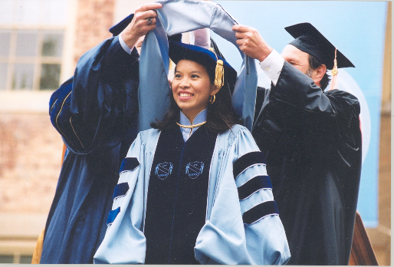
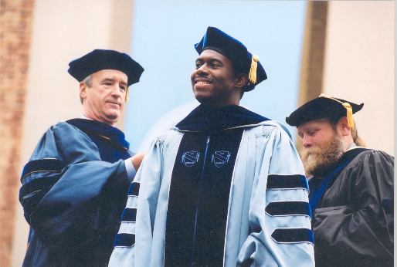
Visit them & other dedicated mentors at
http://gradschool.unc.edu

