Slide 1
Associated Press
The University Writing Center

Slide 2
What is ap?
The “rulebook” for newswriting.
As AP says, it’s “part dictionary, part textbook, part encyclopedia.”
Some guiding principles behind AP style are:
Consistency
Clarity
Accuracy
Brevity

Slide 3
What is ap? cont.
AP is different from academic writing
AP is written in an inverted pyramid format (shown on next slide)
AP is short and to the point
There are NO citations in AP

Slide 4
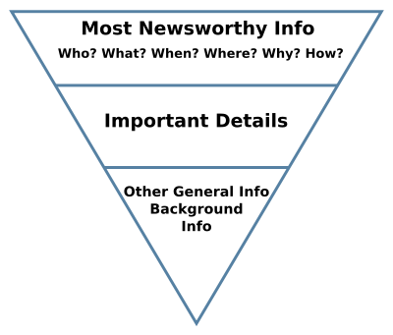
The Inverted pyramid
The Inverted Pyramid

Slide 5
Sentences and quotes

Slide 6
Sentence Structure
Get straight to the point – avoid wordiness
Paragraphs in the journalism world can be anywhere from one to three sentences.
Attributions at the end of the sentence/quote.
“I speak for the trees,” the Lorax said.

Slide 7
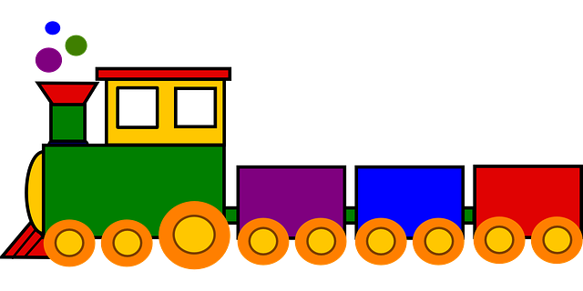
Most important to least important information
Think of your story as a train.
Train horn: catches your audiences attention (lead)
Fire up the engine – tell the important information to get the train going: What, Who, When, Where, Why and How.
Put the least important information last – don’t waste your train’s energy explaining the small stuff.

Slide 8
Leads
AVOID: flowery language, excessive wordiness, do not begin with “It”
Not all leads include a “why”
Leads are usually only one to two sentences long.

Slide 9
Lead Example:
WHO
WHAT
Over 100 kittens adopted by a UNC Pembroke student at the Robeson County Humane Society on Feb. 24 to relieve stress for midterm exams.
WHERE &
WHY
WHEN

Slide 10
AP style Guidelines and tips

Slide 11
Abbreviations

Slide 12
Streets
NEVER abbreviate:
Road
Drive
Circle
Alley
If there is a number -> abbreviate.
EX: 123 Maple St.
123 Maple Ave.
123 Maple Blvd.

Slide 13
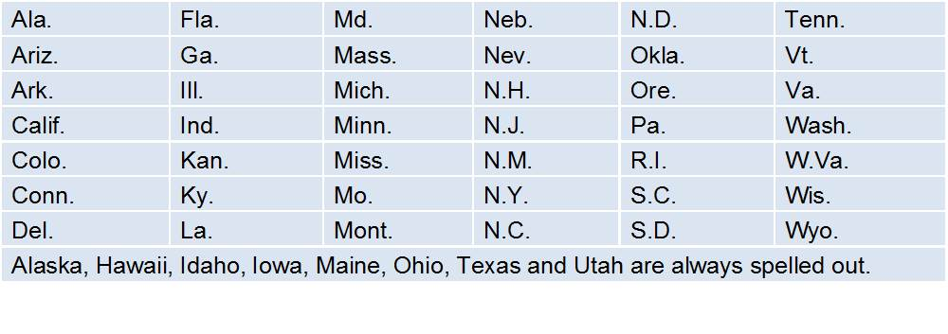
States

Slide 14
Dates
Do not write the year if the event is present
Only abbreviate months when they are included with a date
David’s birthday is in February.
David’s birthday is Feb. 28.

Slide 15
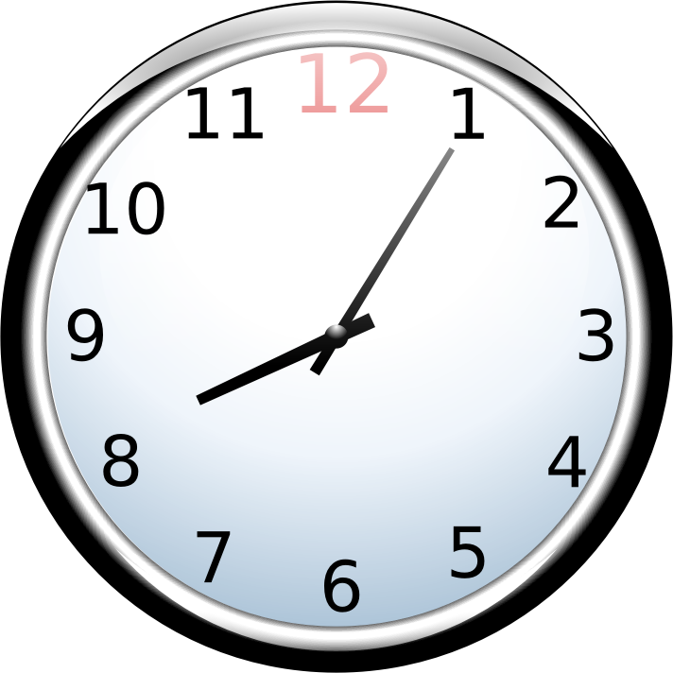
Time
Morning: a.m.
Night: p.m.
Specific times:
5 p.m. <- when the time does not include minutes do not write out (EX: 5:00)
5:30 p.m.

Slide 16
Positions and titles
DO NOT ABBREVIATE:
President
Vice president
Abbreviate before the name, not after.
Lt., Dr., Gov., Rep., Rev., Sen., ect.
NEVER USE Mr. and Mrs.

Slide 17
Positions and Titles Cont..
Do not capitalize after the name
Gov. Pat McCory
Pat McCory, governor of North Carolina.
President Barack Obama
Barack Obama, president of the US

Slide 18
Capitalization

Slide 19
DO
DO NOT
Proper nouns
Geographic regions
Specific government units
Formal names
Seasons
Points of the compass (north, south, east, west)
Fields of study (unless it is a proper noun)
The Department of Biology
She is studying biology and journalism
President when not affiliated with a name

Slide 20
numbers

Slide 21
Numbers: the basics
Spell out numbers one through nine
Use numerals for 10 and above
Exceptions:
Age: She is 6 years old.
Percentage: The stock prices went up 6 percent. (never use the percentage sign)
Dimensions: She is 5 feet 2 inches tall.
Money: The candy bar cost $2.
Dates: Today is Feb. 2.

Slide 22
Weather

Slide 23
Weather: Basics
Spell out minus and below
Spell out zero
Be sure to check terminology.
EX: We can expect for the temperature to reach the mid 90’s.
EX: Temperatures are expected to fall 15 degrees by midnight.
EX: A blizzard/snow is headed towards the piedmont. <- which one is it? Be sure to know the difference

