Slide 1
October & November 2021 NC-HCAP
NEWSLETTER
NC - HCAP participating in Pembroke Day

Slide 2
Recent graduates - NC – HCAP Alumni
Grace Davis graduated from the Physician Assistant Program at Presbyterian College .

Slide 3
NC-HCAP Students recently admitted to Professional Health Programs
Nakiya Locklear
Campbell University – Pharm D
Olivia McCoy
Campbell University - PharmD
Glorimar Cruz-Pagan
Gardner-Webb University
Physician Assistant Studies Program

Slide 4
Cameron Wade
Methodist University
Doctor of Physical Therapy Program
Jada Jacobs
Methodist University
Physician Assistant Studies Program
Savannah Jones
Methodist University
Physician Assistant Studies Program

Slide 5
Congratulations, to NC-HCAP student & Health Careers Club President Sara Baxley…. She’s Officially a Nationally Certified Paramedic!!

Slide 6
Health Careers Club Meeting
Methodist University Physician Assistant Studies Program
First in-person meeting since COVID.

Slide 7
EMT course will be held on UNCP’s campus Spring 2022. If you are interested contact us at hcap@uncp.edu.

Slide 8
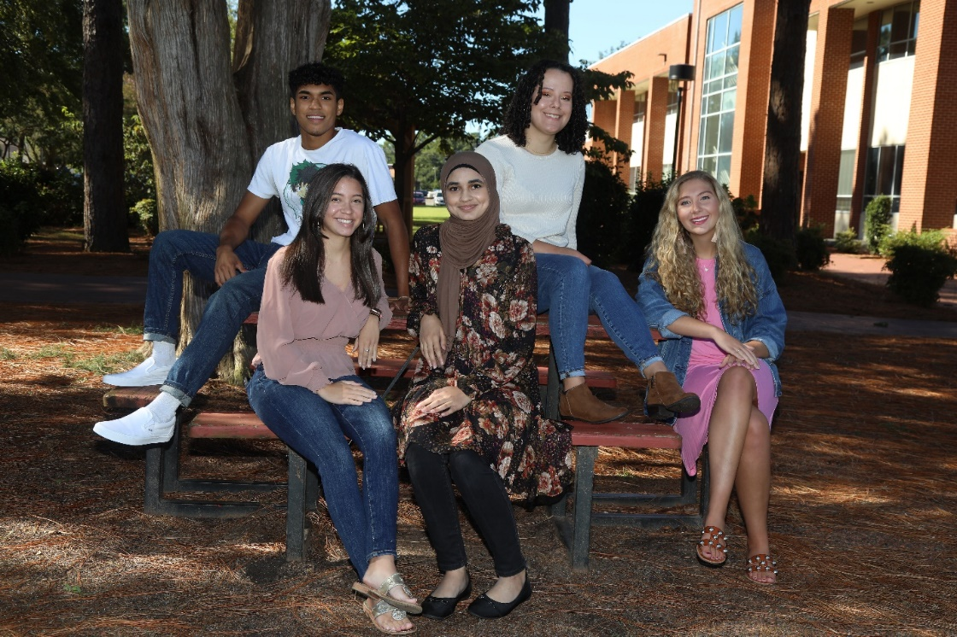
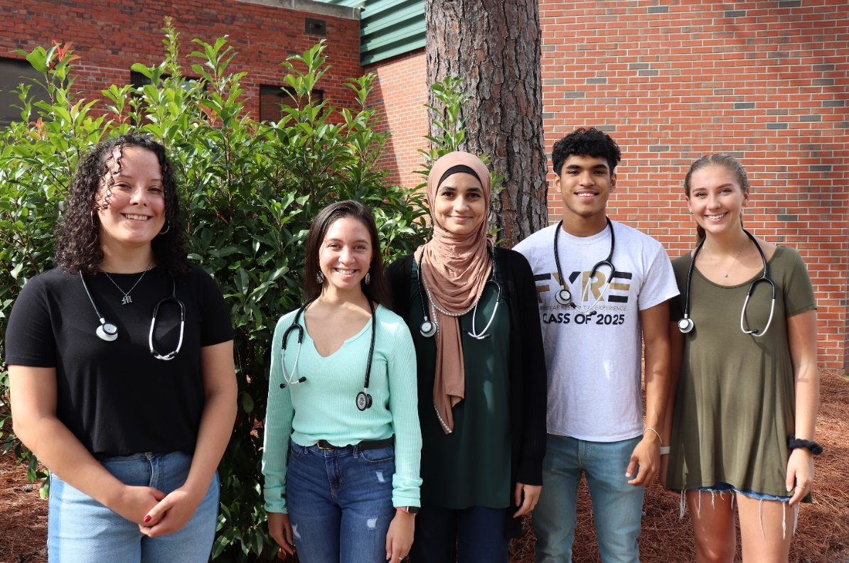
Early Assurance Scholars
Jazmine Locklear, Yaqot Nasser, Sayeed Kabir, Mackenzie Dukes, Lindsay Branch

Slide 9
Advising Week –
NC-HCAP Department advised over 250 students during the month of October.
If any students have not registered yet, you still have time. If you need help, please call us
910-521-6673 or email hcap@uncp.edu.

Slide 10
HCAP students had a Krispy Kreme fundraiser and raised over $200.00.

Slide 11
Health Careers Club Meetings
Fall 2021
-Methodist PA Program
-East Carolina University Graduate School
-Wingate University Masters in Public Health
-Life University-Chiropractic Medicine
-UNC Chapel Hill

Slide 12
NC-HCAP Alumni Spotlight
Ms. Grace Davis, BS, MPAS, PA-C
Grace Davis, has joined Robeson Digestive Diseases as their newest Gastroenterology PA.
Ms. Davis graduated in 2017 from UNC Pembroke with a degree in Biology, and she graduated in 2021 from the Physician Assistant Program at Presbyterian College.

Slide 13
From the HCAP Department

