Slide 1
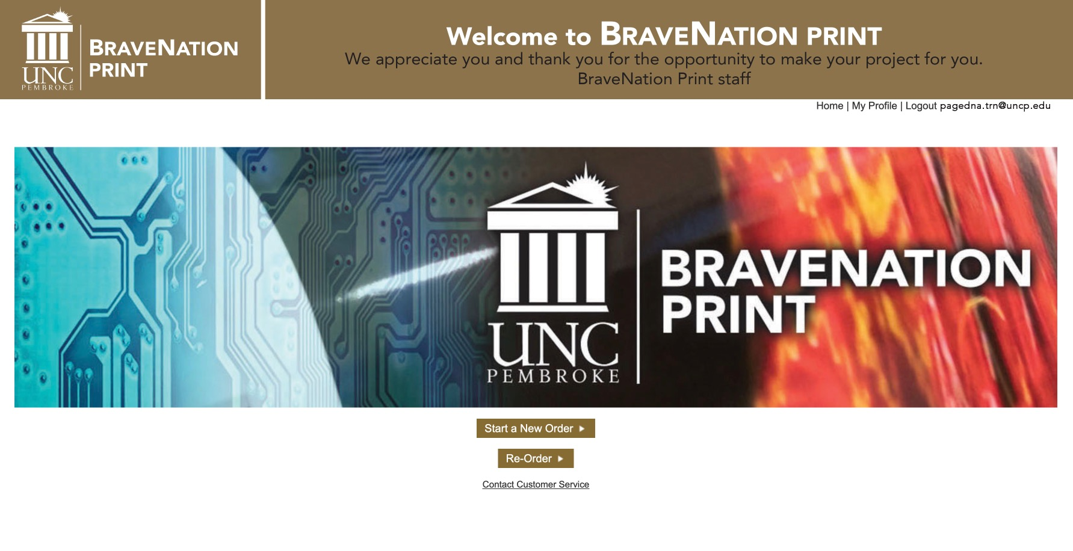
Select Start a New Order

Slide 2
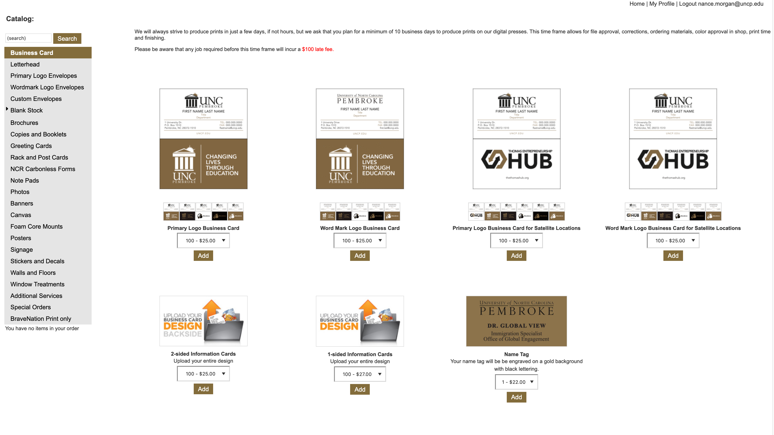
This is the catalog page. Select or search from the options on the left. You will automatically be taken to the business card page, but simply select your desired choice to be taken there.
Notes:
This is the catalog page. Select or search from the options on the left. You will automatically be taken to the business card page, but simply select your desired choice to be taken there.

Slide 3
While we are on the subject, lets look at Business Cards. Standard Business cards are dynamic and allow you to fill in certain information. Many of our stationery items like envelopes and letterhead are also dynamic.
First pick the style front you want; Primary Logo or Wordmark Logo. For our demo we will choose the Primary Logo.
Notes:
This is the catalog page. Select or search from the options on the left. You will automatically be taken to the business card page, but simply select your desired choice to be taken there.

Slide 4
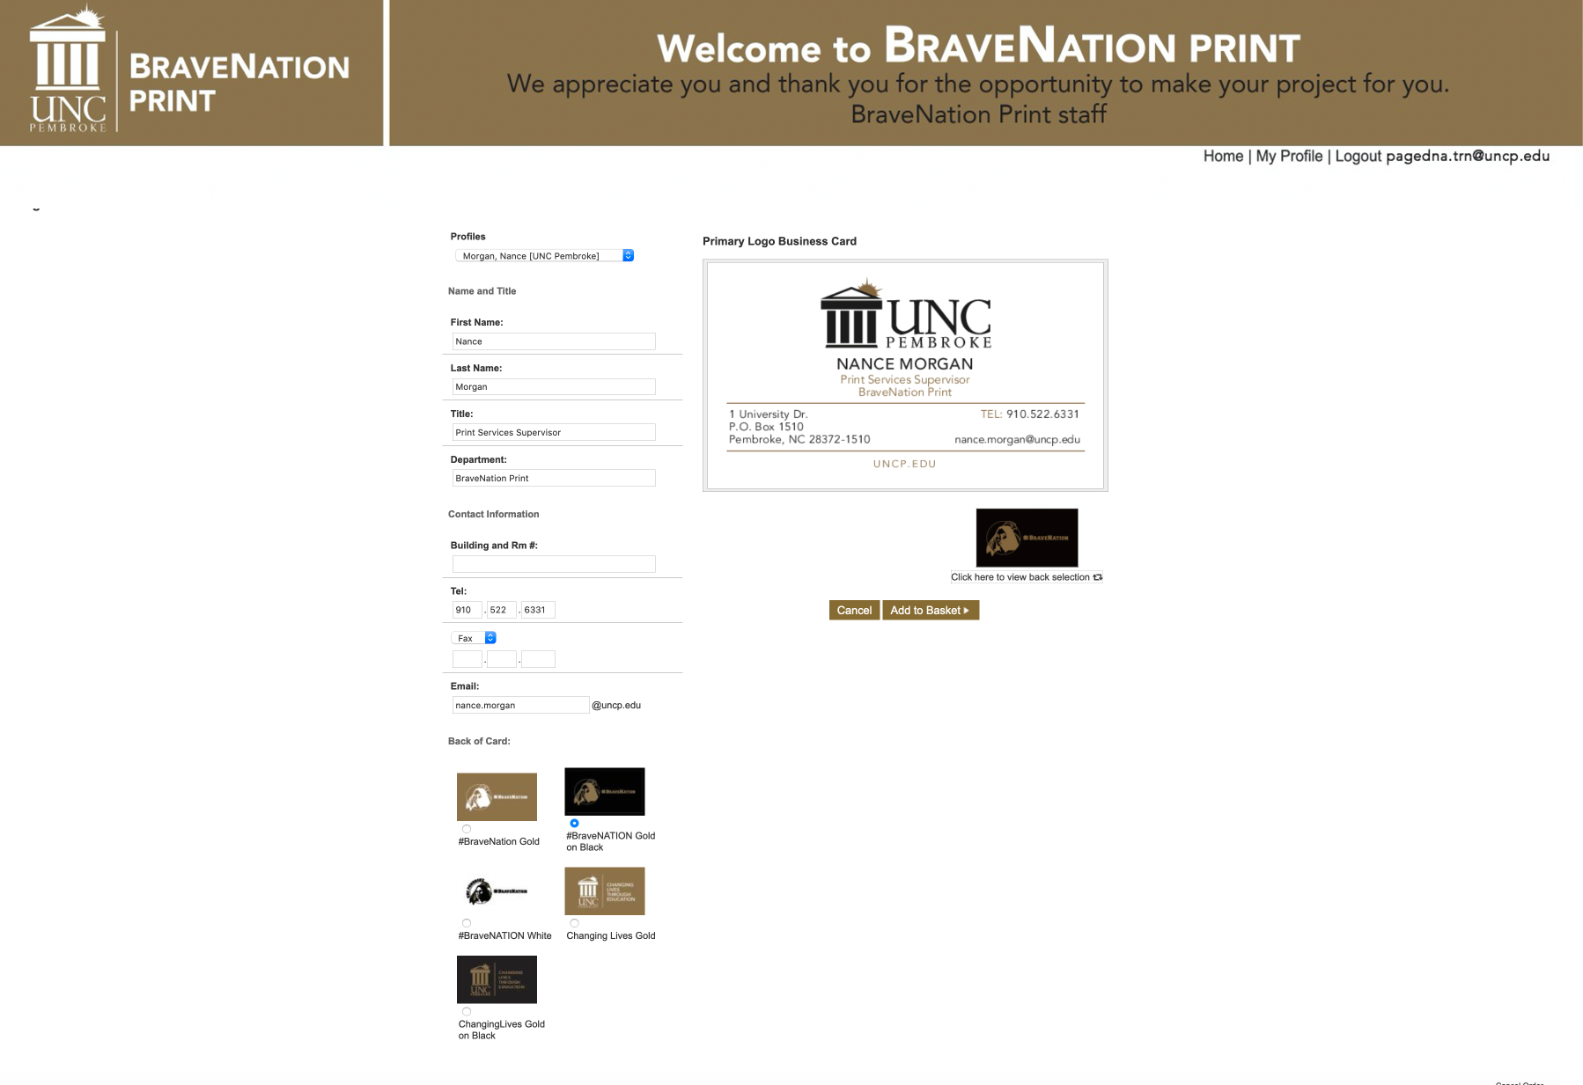
Fill your dynamic information
into the text boxes and select
your desired back.
When you are satisfied
Select Add to Basket.
Notes:
Fill in your dynamic information and select your desired card back

Slide 5
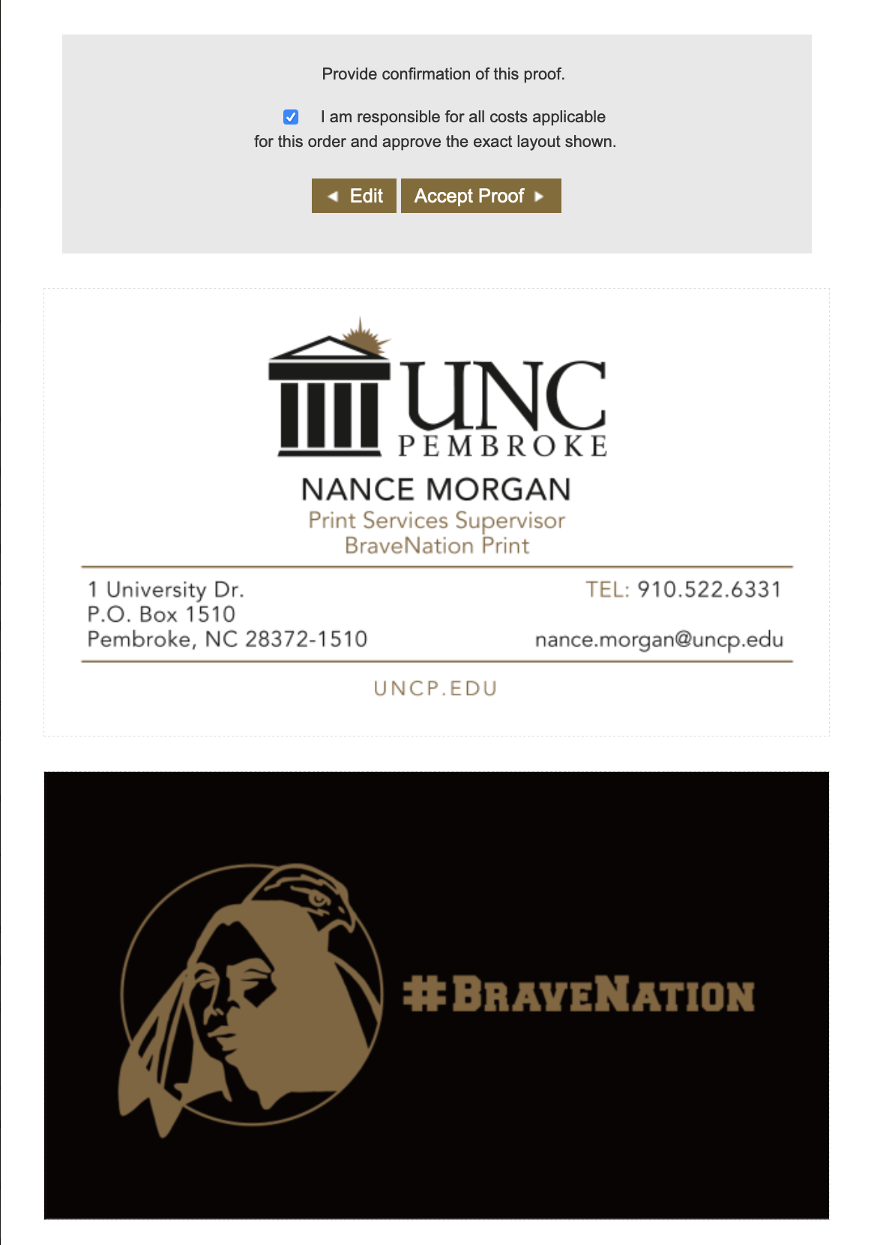
Accepting the proof:
Once the proof generates you have 1 more chance to review.
If you discover an error simply hit edit and you will be returned to the previous page.
To accept check the box and select Accept Proof.

Slide 6
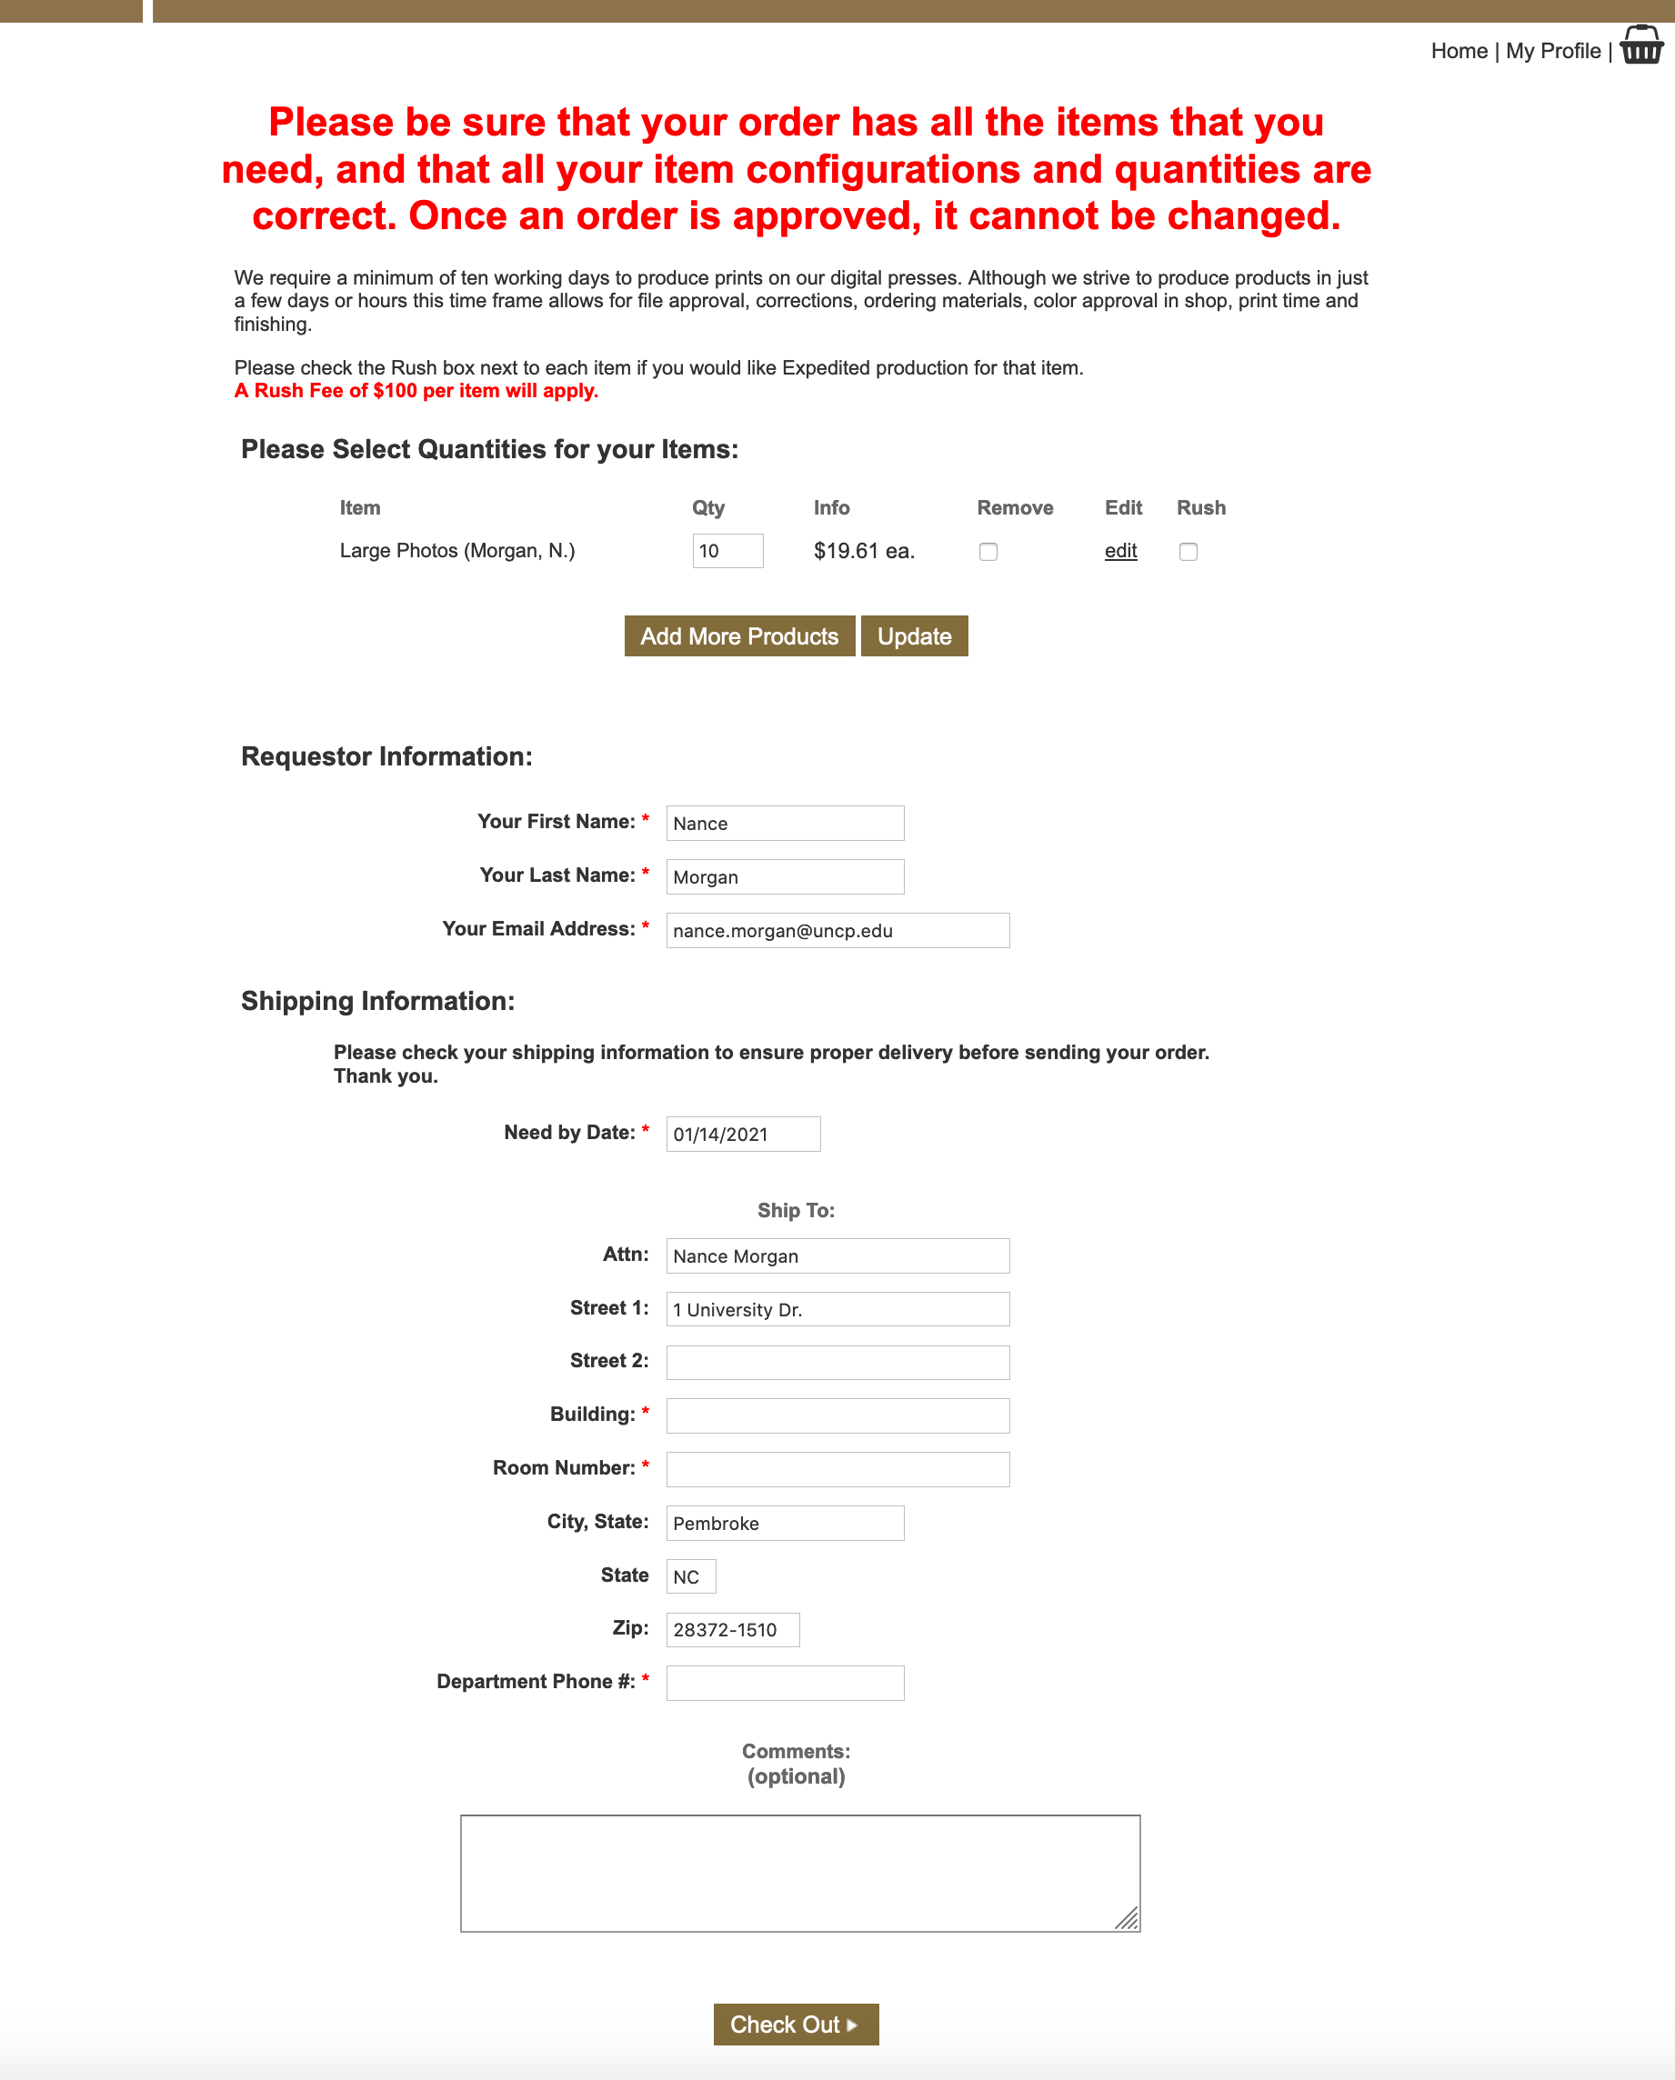
Here you will see the total of your order and what you ordered.
If you have other items to order, click the Add More Items button.
Select rush if you need sooner than 5 business days and click Update.
Fill in requestor (that’s you).
Select a need by date.
We require 5 business days, or a late fee will be added to your total.
Fill in shipping information. Red asterisks indicate required fields.
Include any questions or comments here. This is optional.
Check Out

Slide 7
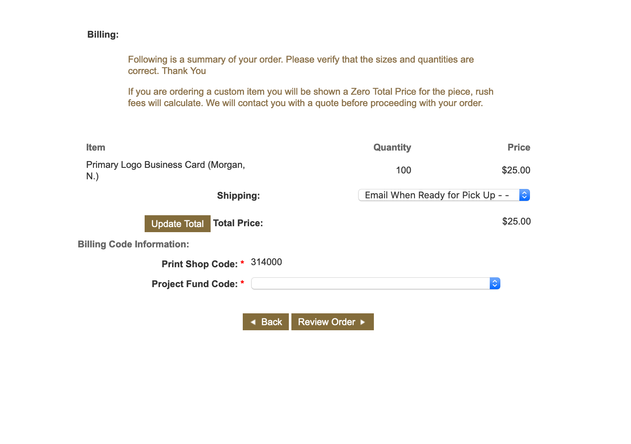
The Billing Page: Here you see your final price, the Print Shop Fund code and a drop down for the Shipping Method and Project Fund Code.
Type the fund code in and it will generate within the drop-down box. Once all that is done select Review Order.

Slide 8
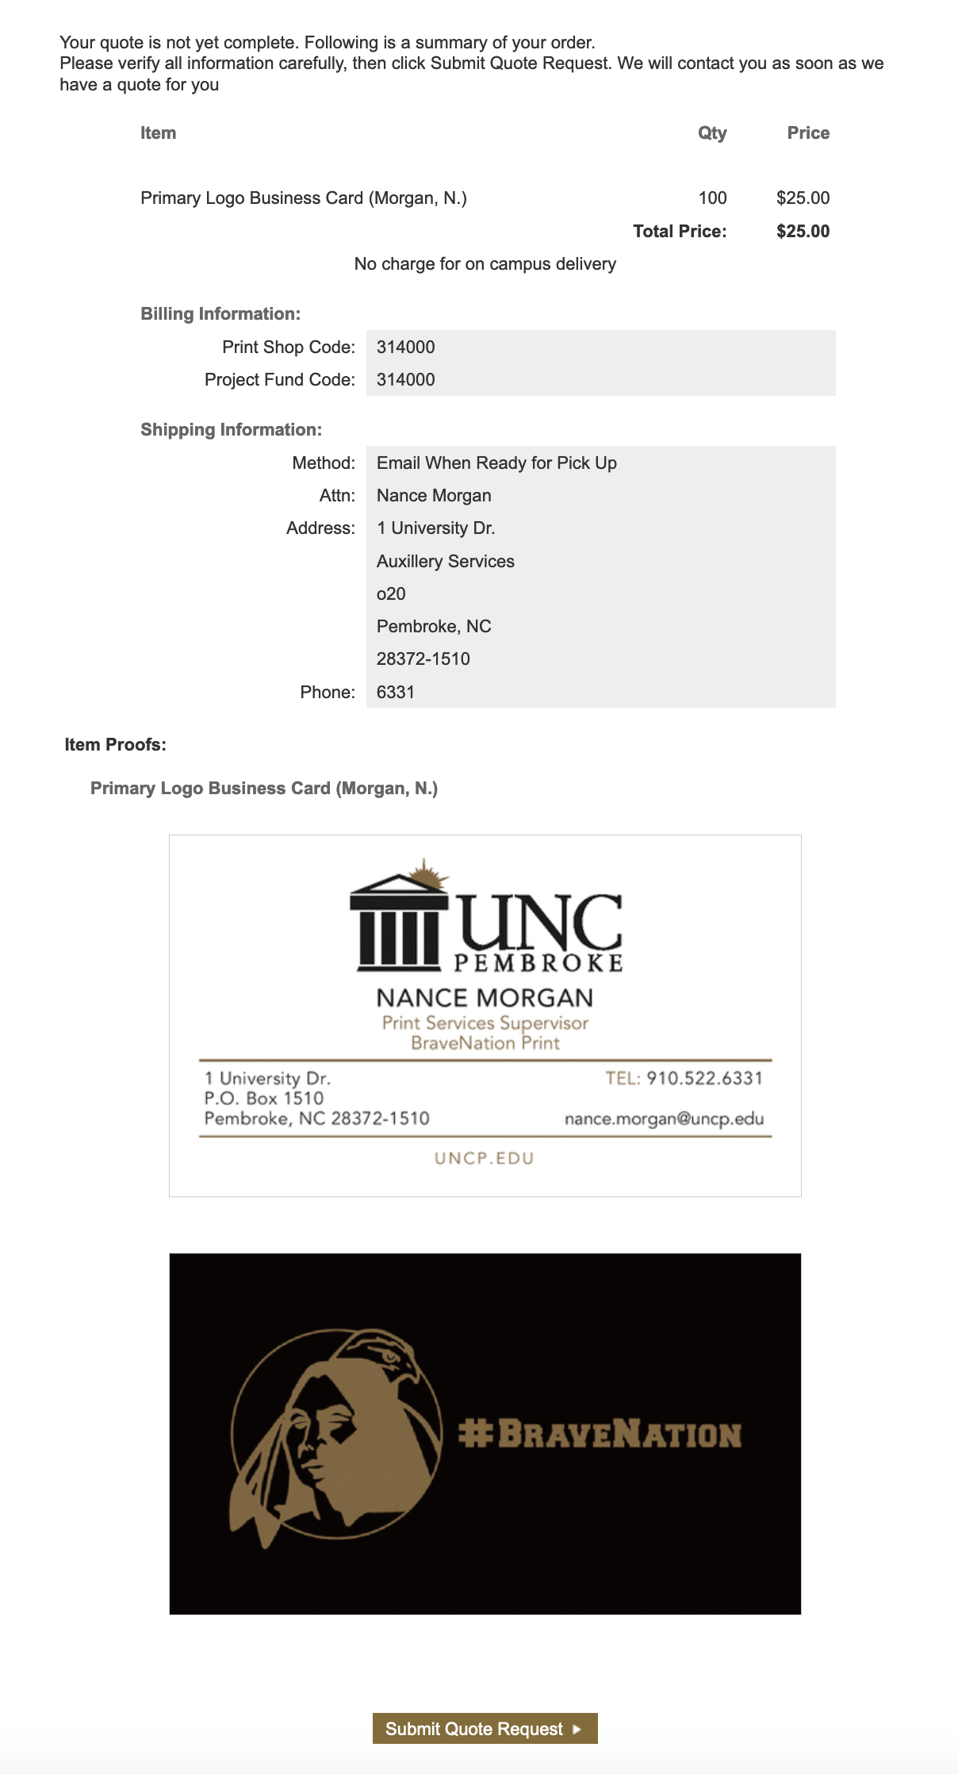
Your order is not yet complete. This is a summary of your order.
Verify all information carefully, then click Submit Request. This will take you to the final step.

Slide 9
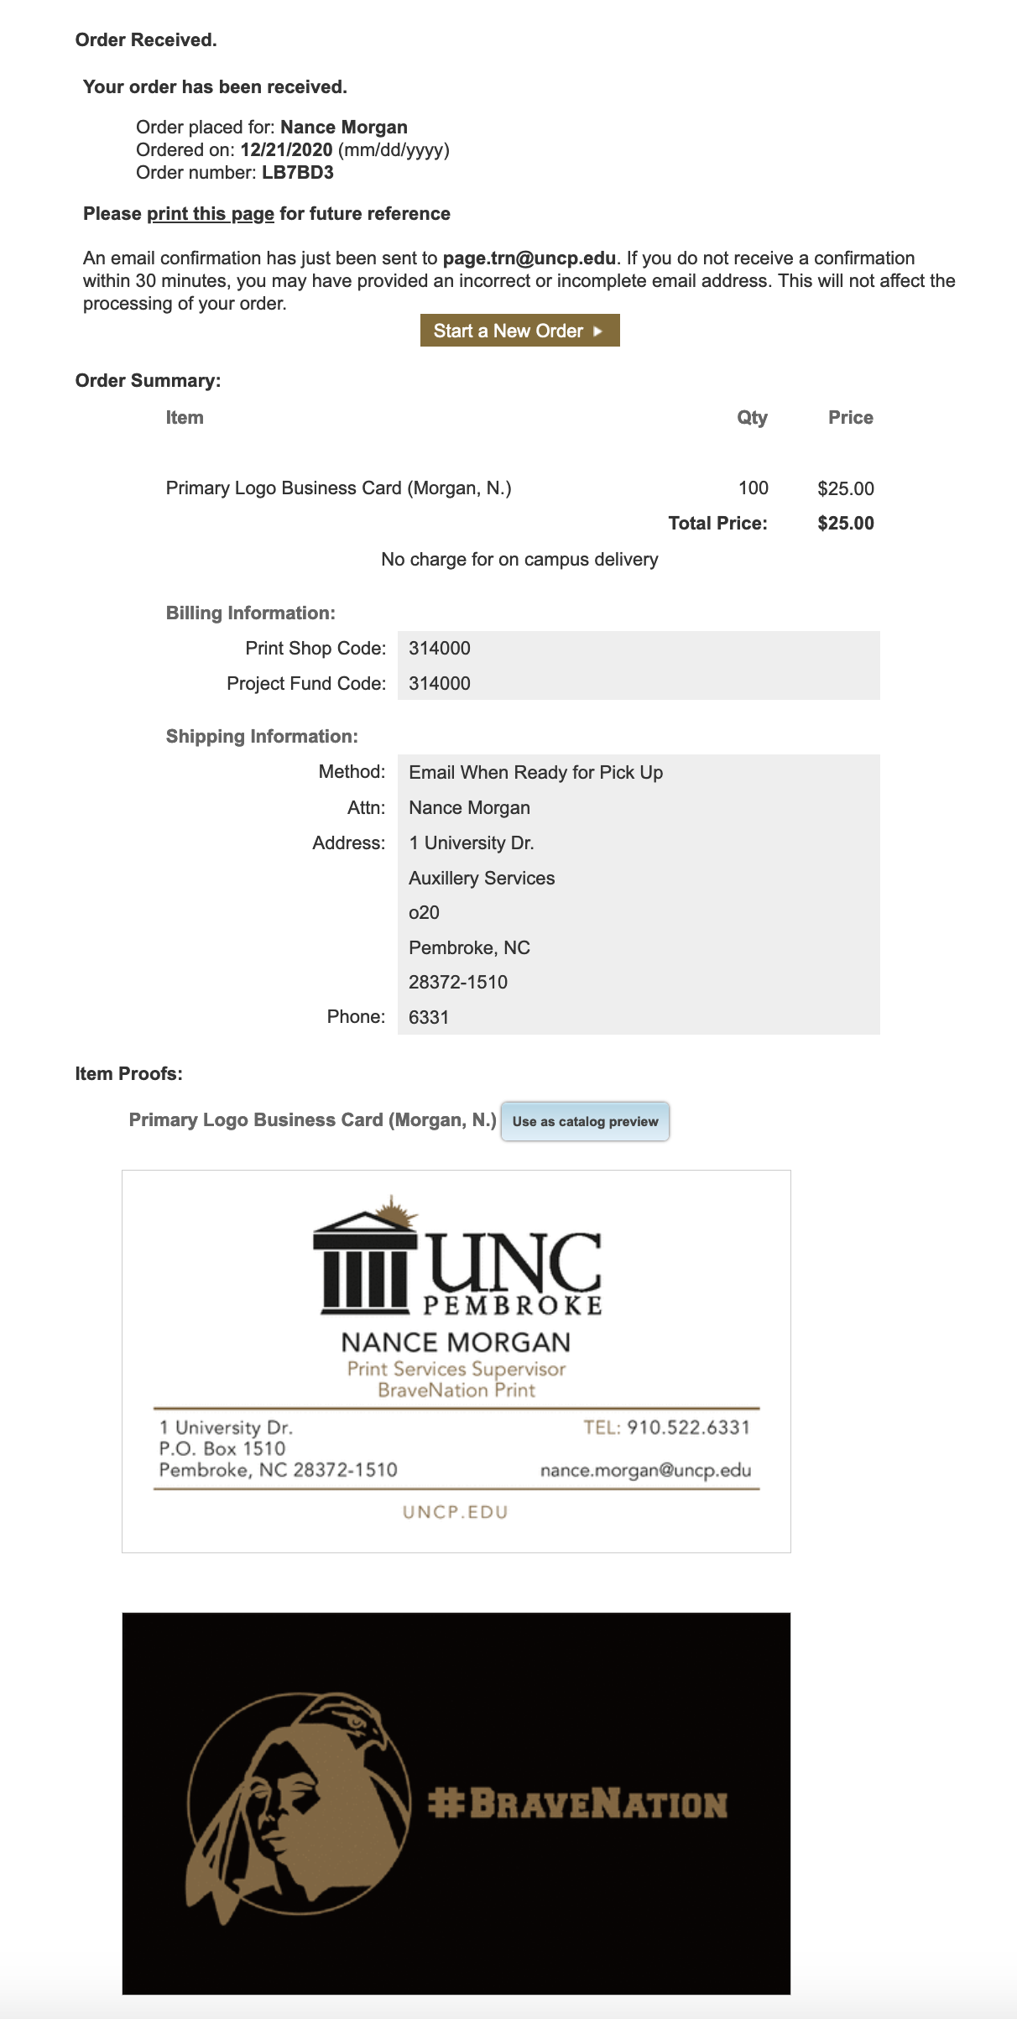
This is the order received page. It includes a proof, the price and information about your order, including an order number. Please keep this information for your records and refer to the order number when you call our customer service lines to inquire about your print job.
Thank you for choosing BraveNation Print.

