Slide 1
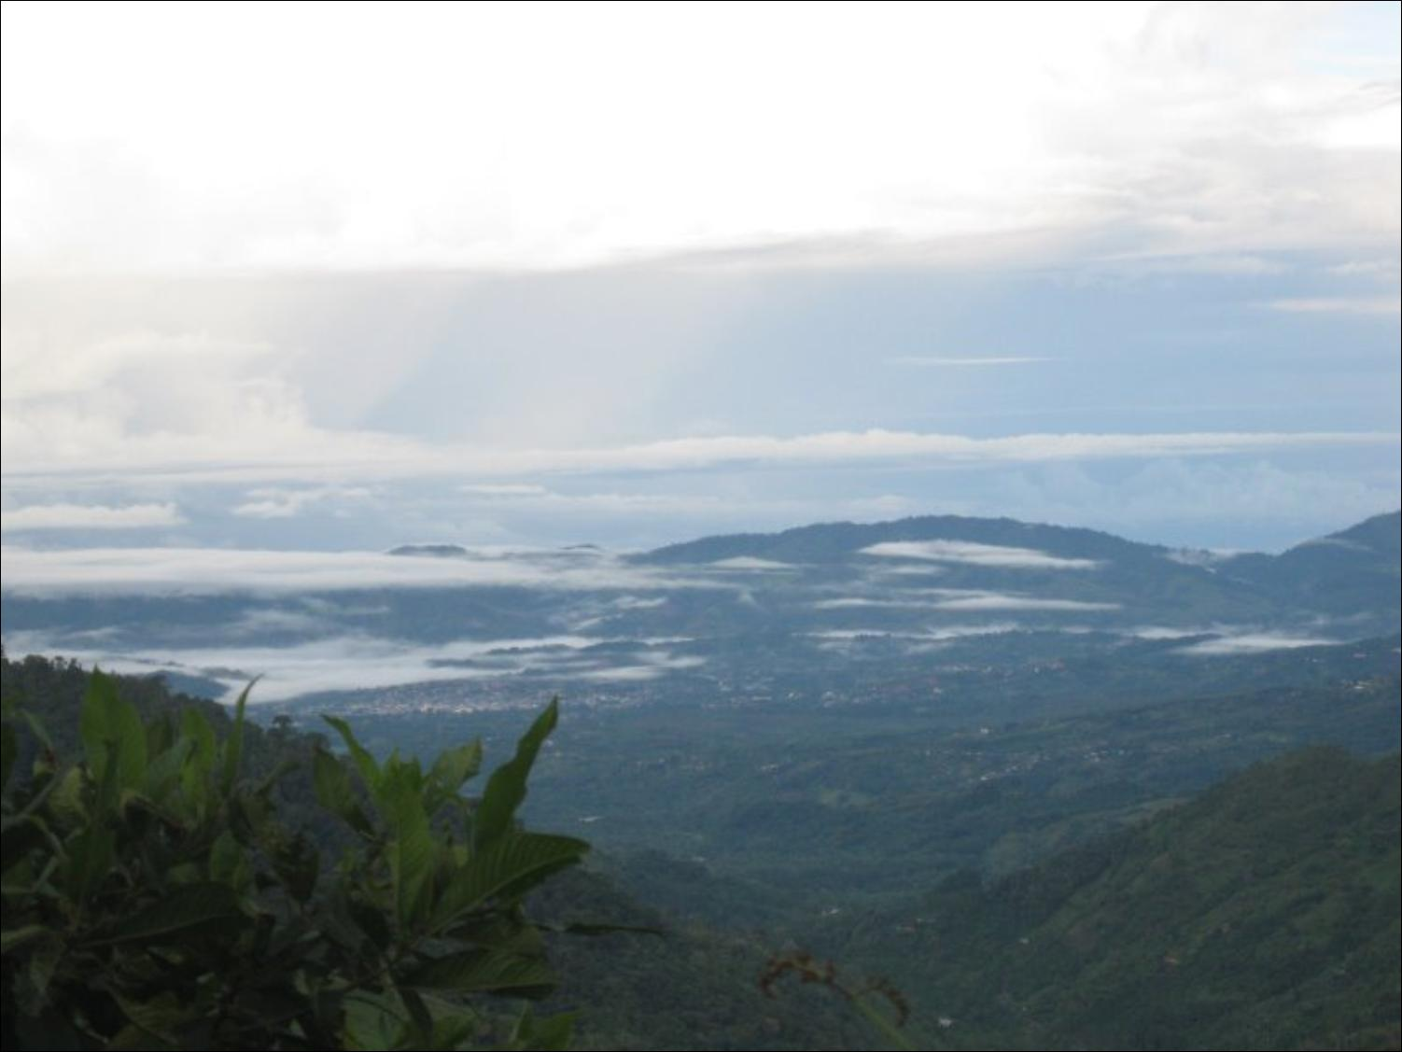
BIO 1060: Exploring Life’s Diversity
Non-Major’s Gen-Ed Biology Course
Available for Fall and Spring!
Explore the diversity of life on Earth, along with the evolutionary relationships of organisms large and small. From bacteria to fungi, plants to animals, learn what makes each unique, and discover how they all interact …as well as the impact man has on this wonderful world we live on.
Official course description:
A survey of the Kingdoms of living organisms to include an introduction to the theory of evolution and the evidence for evolution, and an introduction to the fundamental principles of ecology. This course will not satisfy the prerequisite requirement for other biology courses. Credit, 3 semester hours.
Explore your world!

